Slide 1



DIRECT-TO-EMPLOYER PLAN
August 19, 2024

Slide 2


Market Leader in Private-Labeled Plans
Louisville, KY
OneHealth Plan
Cincinnati, OH
TCH Optimal
Bentonville, AR
Northwest Health Plan
Knoxville, TN
East Tennessee Health Plan
Meridian, MS
Affinity Health Plan
Fort Myers, FL
Lee Health Care Partners

Slide 3

Key Incentive Plan (KIP) Profit Generation Opportunities for Just Health
1
2
Patient Steerage
Covered members of the Key Incentive Plan are more likely to seek services with Just Health than they would be in a standard PPO plan because they receive indemnity benefits and the financing credit card.
These incentives increase CarePoint’s commercial market share and commercial profit within this plan.
Increased Margin
Because of the partnership between Key Benefits, and because patients have a financing path for medical costs, Just Health can expect higher realized revenue per patient from members of the Key Incentive Plan.
This partnership increases Just Health’s realized revenue per patient and lowers collection costs.

Slide 4
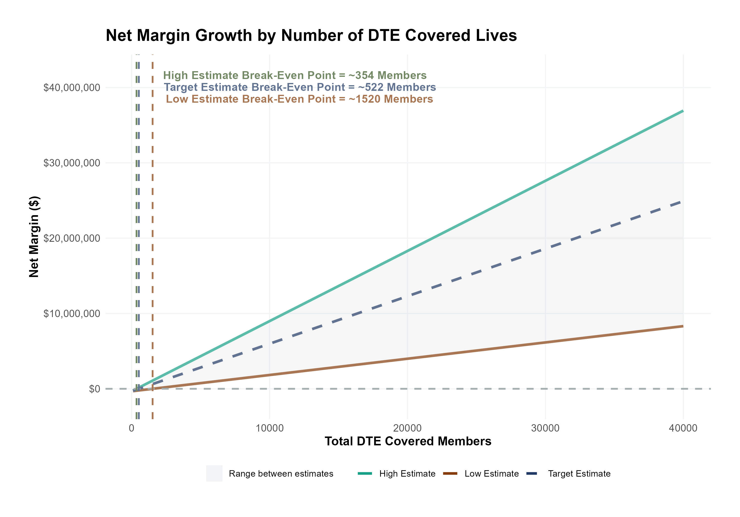
Estimated Financial Returns and Assumptions
Patient Steerage Assumptions
Net Margin Growth by Number of KIP Covered Lives
KBA currently estimates that Just Health has 21% inpatient market share, and 13% outpatient market compared to hospitals/clinics in Union, Essex and Hudson Counties. We expect within-KIP steerage to increase to (inpatient/outpatient):
SINGLE-YEAR PROJECTION
Low
Target
High
25%/15%
27.5%/17.5%
30%/22%
Commercial Margin Assumptions
KBA observes a Just Health 41.8% commercial margin. We estimate that this margin will improve for patients covered by the KIP plan through higher collections as follows:
Low
Target
High
40.5%
45.5%
50.5%
Total KIP Covered Members

Slide 5
SINGLE YEAR SUMMARY
KIP Covered Members Financial Analysis | DTE Covered Members Financial Analysis | DTE Covered Members Financial Analysis | DTE Covered Members Financial Analysis | DTE Covered Members Financial Analysis | DTE Covered Members Financial Analysis | DTE Covered Members Financial Analysis | DTE Covered Members Financial Analysis
Target Estimate With 6.5% Steerage to Just Health and a 10 Percentage-Point Improved Margin for KIP Patients. | Target Estimate With 6.5% Steerage to Just Health and a 10 Percentage-Point Improved Margin for KIP Patients. | Target Estimate With 6.5% Steerage to Just Health and a 10 Percentage-Point Improved Margin for KIP Patients. | Target Estimate With 6.5% Steerage to Just Health and a 10 Percentage-Point Improved Margin for KIP Patients. | Target Estimate With 6.5% Steerage to Just Health and a 10 Percentage-Point Improved Margin for KIP Patients. | Target Estimate With 6.5% Steerage to Just Health and a 10 Percentage-Point Improved Margin for KIP Patients. | Target Estimate With 6.5% Steerage to Just Health and a 10 Percentage-Point Improved Margin for KIP Patients. | Target Estimate With 6.5% Steerage to Just Health and a 10 Percentage-Point Improved Margin for KIP Patients.
KIP Members | Pre-KIP Revenue | Pre-KIP Margin | KIP Revenue | KIP Incr. Revenue | KIP Total Margin | KIP Incr. Margin | Net Margin Less KIP Fees
100 | $ 235K | $ 83K | $ 319K | $ 84K | $ 145K | $ 62K | $ -267K
500 | $ 1,174K | $ 417K | $ 1,597K | $ 422K | $ 727K | $ 310K | $ -14K
1,000 | $ 2,349K | $ 834K | $ 3,193K | $ 844K | $ 1,453K | $ 619K | $ 301K
2,500 | $ 5,872K | $ 2,085K | $ 7,983K | $ 2,110K | $ 3,633K | $ 1,548K | $ 1,248K
10,000 | $23,489K | $ 8,341K | $31,930K | $ 8,441K | $14,532K | $ 6,191K | $ 5,981K
20,000 | $46,978K | $16,682K | $63,861K | $16,883K | $29,063K | $12,381K | $12,291K
NOTE: Please see detailed financial analysis and assumptions used starting on page 15.
Financial projections do not include 340B contribution margin, which could represent $136 PMPM by optimizing 340B through Rx plan design, JH’s approved site(s) with network integration, and development of JH’s proprietary PBM program.

Slide 6
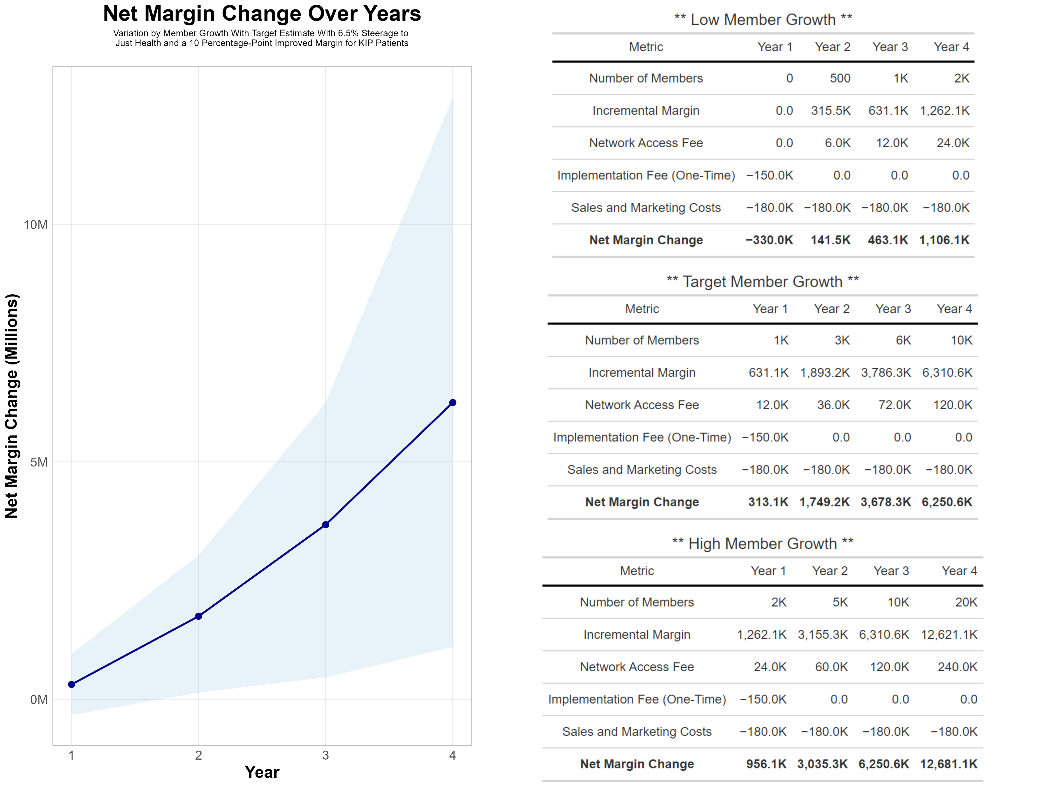
FOUR-YEAR PROJECTIONS

Slide 7
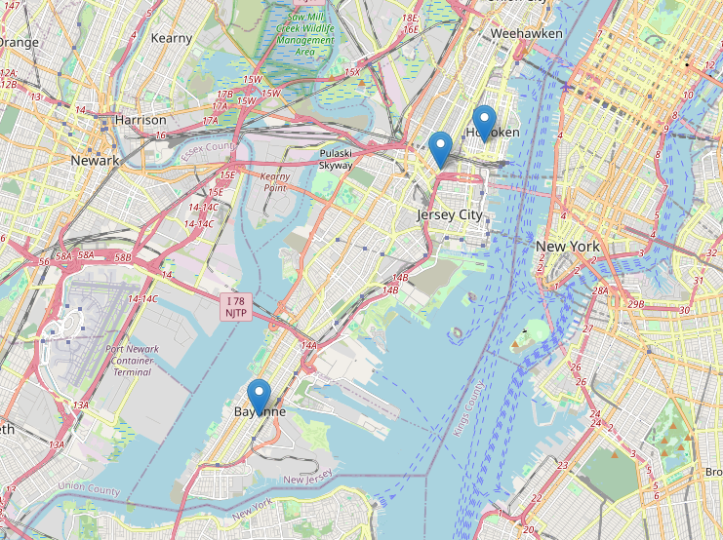
Significant Opportunity for Plan Growth Researched for Union, Essex and Hudson Counties
Target Market 2,500+ Employers 410,000+ Employees 630,000+ Members
 | Employer Size Group (# of Employees)
 | 50-100 | 101-200 | 201-400 | 401-1,000 | 1,001-3,000 | 3,000+
Commercial Employers Headquartered in Union, Essex or Hudson Counties | 1,468 | 597 | 417 | 230 | 64 | 54
 | 50-100 | 101-200 | 201-400 | 401-1,000 | 1,001-3,000 | 3,000+
Estimated Employees of Above Employers | 110,100 | 89,550 | 125,100 | 161,000 | 128,000 | 486,000
 | 50-100 | 101-200 | 201-400 | 401-1,000 | 1,001-3,000 | 3,000+
Estimated Members of Above Employers | 154,140 | 125,370 | 175,140 | 225,400 | 179,200 | 680,400

Slide 8

the missing piece to population health success
Patient engagement is the failure point of population health efforts. Direct employer participation and JH’s clinical leadership is key to driving patient engagement.
KBA’s KIP strategy positions Just Health to grow commercial market share by reducing per-employee plan costs even further at a time when employers are desperate for a path to better value.
Just Health can demonstrate greater completion rates for Standards of Care for the Chronically Ill, driving better care & cost outcomes.
Adding JH’s managed care processes to KBA’s patented care management programs will turbocharge results – Positioning JH as a transformational population health leader.
Just Health CAN PROMOTE THESE RESULTS FROM DAY ONE!!

Slide 9

CHRONIC CONDITION | MINIMUM ANNUAL CARE RECOMMENDED
ASTHMA | 2 Clinical Evaluations 1 Spirometry (for patients 10 years of age or older)
ATRIAL FIBRILLATION | 1 Clinical Evaluation
CHRONIC OBSTRUCTIVE PULMONARY DISEASE | 1 Clinical Evaluation 1 Spirometry
CHRONIC VENOUS THROMBOTIC DISEASE previously listed as Thrombo-embolic Disease | 1 Clinical Evaluation
COPD WITH PULMONARY HYPERTENSION/COR PULMONALE | 2 Clinical Evaluations 12 months of supplemental 02 Tx
CHRONIC KIDNEY DISEASE | 1 Clinical Evaluation 1 Hgb or Hcrt | 1 Serum Creatinine 1 Serum Potassium | 1 Serum Calcium 1 Serum Phosphorus
CONGESTIVE HEART FAILURE | 1 Clinical Evaluation | 1 Serum Creatinine | 1 Serum Potassium
CORONARY ARTERY DISEASE | 1 Clinical Evaluation | 1 LDL
DEPRESSION | 1 Clinical Evaluation
DIABETES | 2 Clinical Evaluations 2 Glycohemoglobins 1 Serum Creatinine | 1 Lipid Panel IF no nephropathy Dx or ACE/ARB Rx, 1 Urine Albumin/Creatinine ratio, Total Protein
EPILEPSY | 1 Clinical Evaluation
HUMAN IMMUNODEFICIENCY VIRUS INFECTION | 2 Clinical Evaluations 2CBCs I T-Cell/CD-4 Count | 2 HIV Quantifications 1 Pap Smear (for women only, 21 years of age or older)
Hyperlipidemia | 1 Lipid Panel
HYPERTENSION | 1 Clinical Evaluation | 1 Serum Creatinine
HYPERTHYROIDISM | 1 Clinical Evaluation | 1 TSH | 1 T4
HYPOTHYROIDISM | 1 Clinical Evaluation | 1 TSH
METABOLIC SYNDROME | 1 Clinical Evaluation | 1 Lipid Panel | 1 FBS or HgbA1c
MULTIPLE SCLEROSIS | 1 Clinical Evaluation
PARKINSON'S DISEASE | 1 Clinical Evaluation
PERIPHERAL ARTERIAL DISEASE (ATHEROSCLEROSIS] previously listed as Peripheral Vascular Disease | 1 Clinical Evaluation 1 LDL
PRE-DIABETES | 1 Clinical Evaluation | 1 Lipid Panel | 1 FBS or HgbA1c
POLYMYALGIA RHEUMATICA | 2 Clinical Evaluation | 2 ESR or CRP | 1 CBC
PULMONARY HYPERTENSION (UNRELATED TO COPD) | 2 Clinical Evaluation
REGIONAL ENTERITIS (INFLAMMATORY BOWEL DISEASE) | 1 Clinical Evaluation
RHEUMATOID ARTHRITIS | 1 Clinical Evaluation
SLEEP APNEA | 1 Clinical Evaluation
ULCERATIVE COLITIS (INFLAMMATORY BOWEL DISEASE) | 1 Clinical Evaluation
INTEGRATION WITH EPIC EHR SYSTEM
CHRONIC DISEASE MANAGEMENT
The chronic diseases identified include a list of services (i.e. exams, lab work and diagnostics) rendered by a network provider payable at 100% and not subject to the deductible or copay.
KBA shares evidence-based standards of care for 27 chronic conditions directly into Epic.

Slide 10

Transparent PBM Integration
Support of JH’s retail pharmacy(s)
Optimize JH’s 340B drug pricing program
Allows JH to create its own PBM program if desired
Custom telephone number with personalized scripting and separate call tracking & reporting
Fully customizable member welcome booklet & materials
White labeled formulary document and marketing materials
CUSTOM CLIENT SUPPORT:
Specialized call center capabilities
Fully customizable plan designs
Operational access to the platform
Customized process and functions to promote KIP strategy
CLINICAL FLEXIBILITY:
Full portfolio of custom formulary offerings – with optimized formulary shield
Clinical programs that drive towards overall KIP strategy
Options for additional drug savings by driving members to lower cost alternatives
Flexibility to customize or layer on utilization management programs

Slide 11
STOP-LOSS INSURANCE
Tokio Marine
Nationwide
Berkshire Hathaway
Sun Life
Liberty Mutual
Granular (Google)
Companion Life
Crum & Forster
American Fidelity
RGA
KBA has over 20 stop-loss underwriters and carriers that we work with on core employer sponsored plans and KIP health plans;
KBA performs a comprehensive analysis of each stop-loss partner to approve them for our business;
KBA provides comprehensive pricing and medical service analysis for each KIP health plan to ensure proper pricing;
KBA is also evaluated by the stop-loss markets to be an approved claims payer for them;
KBA provides the administration required of the stop-loss markets:
Bordereau Reporting;
Claim Reporting and Reconciliation;
Evaluation of Networks;
Care Management;
Initial Underwriting;
Negotiation of rates and terms; and
Plan Design Actuarial

Slide 12

KIP PROGRAM MARKETING & SALES
KBA WORKS WITH YOU TO MANAGE & SELL:
Branding & Messaging
Direct & Brokerage Sales Distribution – Focused Sales Representative
Brochures, Web Site, Media, etc.
Stop-Loss/Level Funded Down to 20 EE Lives
Sell Through Established Brokers in Your Service Area

Slide 13

Complete Sales Distribution System
BROKER DEVELOPMENT
Identification of Key Distribution Agents
Training and Development
DIRECT SALES
Identification of Key Targets
Working with JH on Specific Employers
SALES ADMINISTRATION
Quote System
Quote Evaluation
Compensation
Meet and Greet
Sales Process
Closing
Stop Loss Negotiations
Reporting & Analysis
Proposal Development

Slide 14
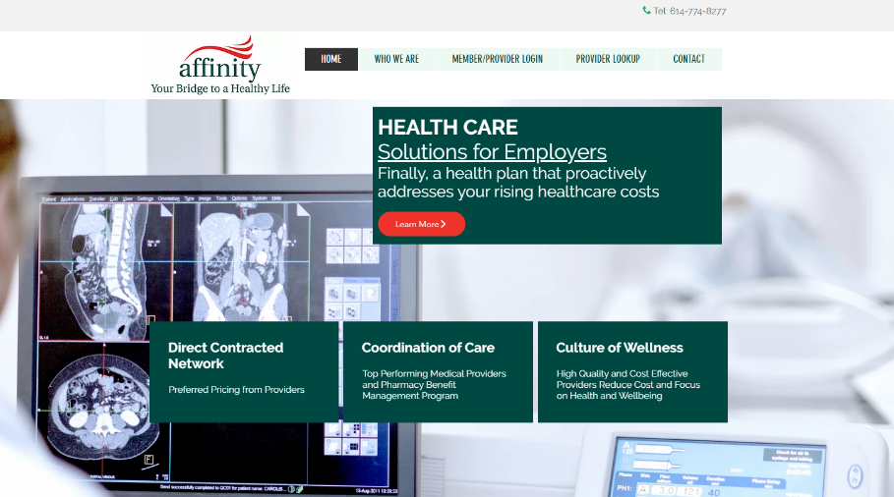








Complete Marketing System
Customized Branding and Messaging
Customized Brochures
Customized Web Site
Targeted Employer Outreach
Sales System (Social Media, Email, Text, etc.)

Slide 15

FINANCIAL PROJECTIONS & ASSUMPTIONS: ESTIMATING CAREPOINT MARKET SHARE AND MARGIN

Slide 16
Estimation of JH’s 2022 Inpatient Payer Mix
Payer Group | Revenue | Payer Mix
All of Just Health (Inpatient) | $3,974,908K | 100%
Medicare | $946,794K | 33%
Medicaid | $807,090K | 28%
Other Government Pay
No-Pay, Charity Care | $275,769K | 7%
Commercial/Self Pay | $2,221,022K | 32%
Estimating Payer Mix
Payer mix estimates were received directly from Just Health
Payer mix, in this context, identifies the percentage of care costs allocated to serving each population.
Estimating Revenue by Group
Key Benefits utilizes the RAND (version 5) estimate of the pricing difference between Medicare and commercial insurance rates. Medicaid and other government programs are estimated to be at the same rate as Medicaid.
In the following models, outpatient payer mix is assumed to mirror the inpatient payer mix.

Slide 17
Estimation of JH’s 2022 Inpatient Payer Mix
Payer Group | Revenue | Payer Mix
All of Just Health (Inpatient) | $3,974,908K | 100%
Medicare | $2,038,409 | 55%
Medicaid
Other Government Pay
No-Pay, Charity Care | $0 | 20%
Commercial/Self Pay | $1,936,493K | 25%
Estimating Payer Mix
Payer mix estimates were received directly from Just Health
Payer mix, in this context, identifies the percentage of care costs allocated to serving each population.
Estimating Revenue by Group
Key Benefits utilizes the RAND (version 5) estimate of the pricing difference between Medicare and commercial insurance rates. Medicaid and other government programs are estimated to be at the same rate as Medicaid.
In the following models, outpatient payer mix is assumed to mirror the inpatient payer mix.

Slide 18
Estimation of Margin for Commercial vs. Government Pay
The RAND data for JH estimates commercial insurance reimbursements at 247% of Medicare Rates
Estimating Commercial Margin
(Calculated through counterfactual of assuming all CMS/Government pay was paying at commercial rates)
Estimating Gov-Pay Margin
(Calculated through counterfactual of assuming all commercial pay was paying at Medicare rate)
Commercial Revenue | $1,936,494K
Gov-pay revenue at 247% current rate | $5,034,883K
Total Revenue | $6,971,377K
Total Costs | $4,058,966K
Net Income | $2,912,411K
 | 42%
Commercial Revenue Divided by 247% | $784,005K
Gov-pay revenue | $2,038,414K
Total Revenue | $2,822,420K
Total Costs | $4,058,966K
Net Income | $ -1,236,546K
 | -44%

Slide 19
Estimating Market Share
Hospital Name | Number of Beds | Inpatient Total Charges | Outpatient Total Charges | Inpatient Percent of Market Total | Outpatient Percent of Market Total (Assuming 56.1% of Physicians Employed by Hospitals)
Bayonne Medical Center | 131 | $ 959,388.1K | $ 656,339.4K | 6% | 3%
Hoboken University Medical Center | 117 | $1,016,197.5K | $ 834,022.0K | 6% | 4%
Christ Hospital | 178 | $1,376,371.1K | $1,033,594.9K | 8% | 5%
Carewell Health Medical Center | 159 | $ 359,576.8K | $ 145,263.6K | 2% | 1%
Cooperman Barnabas Medical Center | 557 | $2,212,144.8K | $1,176,346.7K | 14% | 6%
Hackensack Meridian Health, Mountainside Medical | 185 | $ 652,366.6K | $ 655,269.5K | 4% | 3%
Palisades Medical Center | 186 | $ 491,093.8K | $ 366,514.0K | 3% | 2%
Robert Wood Johnson University Hospital At Rahway | 122 | $ 527,462.1K | $ 318,400.3K | 3% | 2%
Hudson Regional Hospital | 102 | $ 353,205.1K | $ 418,896.0K | 2% | 2%
Saint Michael's Medical Center | 147 | $ 443,958.1K | $ 470,001.9K | 3% | 2%
The University Hospital | 351 | $1,785,402.9K | $ 868,377.5K | 11% | 4%
Clara Maass Medical Center | 280 | $ 884,145.6K | $ 506,465.8K | 5% | 3%
Newark Beth Israel Medical Center | 422 | $1,881,348.4K | $ 803,991.3K | 12% | 4%
Trinitas Regional Medical Center | 220 | $ 716,322.7K | $ 764,446.5K | 4% | 4%
Jersey City Medical Center | 296 | $1,166,831.2K | $ 755,410.2K | 7% | 4%
Overlook Medical Center | 443 | $1,449,425.7K | $1,541,202.4K | 9% | 8%
For outpatient market share, it is estimated that only 56.1% of local physicians are employed by area hospitals (Research from the Physician Advocacy Institute: https://www.physiciansadvocacyinstitute.org/Portals/0/assets/docs/PAI-Research/PAI-Avalere%20Physician%20Employment%20Trends%20Study%202019-2023%20Final.pdf?ver=uGHF46u1GSeZgYXMKFyYvw%3d%3d)

Slide 20
Hospital Metrics | Hospital Metrics | Hospital Metrics | Hospital Metrics
Metric | Christ Hospital | Hoboken University Medical Center | Bayonne Medical Center
Total Inpatient Patient Revenue (2021) | $1,612,274K | $1,168,373K | $1,194,261K
Total Outpatient Patient Revenue (2021) | $1,476,876K | $1,304,860K | $1,146,504K
Estimated Medicare Revenue | $318,002.8K | $230,448.3K | $235,554.4K
Estimated Medicaid and Other Government-Pay Revenue | $508,804.5K | $368,717.3K | $376,887K
Estimated Commercial Revenue | $785,466.9K | $569,207.3K | $581,819.4K
Estimated Inpatient Costs | $1,649,666K | $1,191,943K | $1,217,358K
Estimated Outpatient Costs | $1,511,127K | $1,331,183K | $1,168,678K
Estimated Total Costs | $3,160,793K | $2,523,126K | $2,386,035K
Net Income | $-53,726K | $-35,185K | $-28,404.22K
Just Health Reported Payer Mix Percent Medicare | 25.0% | 25.0% | 25.0%
Just Health Reported Payer Mix Percent Medicaid | 30.0% | 30.0% | 30.0%
Just Health Reported Payer Mix Percent Other Government-Pay | 10.0% | 10.0% | 10.0%
Just Health Reported Payer Mix Percent No Pay | 20.0% | 20.0% | 20.0%
Just Health Reported Payer Mix Percent Commercial | 25.0% | 25.0% | 25.0%
Estimated Inpatient Commercial Profit Margin | 41.7% | 41.8% | 41.9%
Estimated Inpatient Market Share | 8.5% | 6.2% | 5.9%
Estimated Outpatient Market Share | 5.1% | 4.1% | 3.3%
1. Most data is taken from the CMS provider cost report | 1. Most data is taken from the CMS provider cost report | 1. Most data is taken from the CMS provider cost report | 1. Most data is taken from the CMS provider cost report
2. Payer mix estimates were received directly from Just Health. | 2. Medicare costs are taken from the Medicare Provider Analysis and Review (MedPAR) | 2. Medicare costs are taken from the Medicare Provider Analysis and Review (MedPAR) | 2. Medicare costs are taken from the Medicare Provider Analysis and Review (MedPAR)
3. Data with 'Estimated' in the title are derived from other data points. | 3. Data with 'Estimated' in the title are derived from other data points. | 3. Data with 'Estimated' in the title are derived from other data points. | 3. Data with 'Estimated' in the title are derived from other data points.
4. Market Share estimates based on total patient revenues with area hospitals. Ambulatory market share based on regional estimates of the percentage of local physicians employed by area hospitals. See Physician Advocacy Institute | 4. Market Share estimates based on total patient revenues with area hospitals. Ambulatory market share based on regional estimates of the percentage of local physicians employed by area hospitals. See Physician Advocacy Institute | 4. Market Share estimates based on total patient revenues with area hospitals. Ambulatory market share based on regional estimates of the percentage of local physicians employed by area hospitals. See Physician Advocacy Institute | 4. Market Share estimates based on total patient revenues with area hospitals. Ambulatory market share based on regional estimates of the percentage of local physicians employed by area hospitals. See Physician Advocacy Institute

Slide 21
FINANCIAL PROJECTIONS & ASSUMPTIONS: ESTIMATING KIP RETURNS

Slide 22
Estimating PMPY Spend (KBA Data)
Category | Standardized Allowed Charges | Standardized Paid Charges | Member Years | Nationwide Average of Paid Claims | Adjusted to Union, Essex and Hudson Counties Rates
Inpatient | $ 561,766,609 | $ 358,815,229 | 105,492 | $ 3,401 | $ 7049
OutPatient | $ 1,223,989,466 | $ 652,333,702 |  | $ 6,184 | $ 3877
Professional | $ 549,353,224 | $ 304,634,120 |  | $ 2,888 | $ 3292
KBA utilizes its data warehouse with greater than $3B in yearly adjudicated charges to estimate PMPY spend by inpatient, outpatient and professional charges. Pharmacy and non-health-system charges are excluded.
Using the Milliman area adjustment factors by zip code, charges are standardized to local estimates.
These estimated charges are conservative as KBA claims average ~15% below the market average.

Slide 23
Pre-KIP Cohort of 5,000 Members | Inpatient | Outpatient | Professional | Total
Revenue† | $ 7,258,861 | $ 2,425,903 | $ 2,059,859 | $ 11,744,624
Net Income‡ | $ 2,342,672 | $ 782,918.5 | $ 664,784 | $ 3,790,375
† Assuming proportional revenues from market shares of 21% (inpatient) and 13% (outpatient)
‡ Conservatively assuming a commercial margin of 32.3% (0.8% of the observed commercial margin)
With KIP | Inpatient | Outpatient | Professional | Total
Revenue⁰ | $ 9,692,375 | $ 3,392,375 | $ 2,880,500 | $ 15,965,250
Net Income* | $ 4,097,284 | $ 1,434,068 | $ 1,217,682 | $ 6,749,034
⁰ Assuming improved market steerage to Just Health of 27%/17%
* Assuming a commercial margin of 42.3%, with a 10 percentage-point increase to reflect lower billing costs and higher patient payments.
Total Increase in Net Income | $ 2,958,659
Network Access Fee (Revenue) of $1 PMPM | $ 60,000
Total Profit Growth | $ 3,018,659
Minus Implementation Fee (One-Time) | -$ 150,000
Minus Sales and Marketing (Annual – Ongoing) | -$ 180,000
Total | $ 2,688,659

Slide 24
Target Estimate With 6.5% Steerage to Just Health and a 10 Percentage-Point Improved Margin for KIP Patients | Target Estimate With 6.5% Steerage to Just Health and a 10 Percentage-Point Improved Margin for KIP Patients | Target Estimate With 6.5% Steerage to Just Health and a 10 Percentage-Point Improved Margin for KIP Patients | Target Estimate With 6.5% Steerage to Just Health and a 10 Percentage-Point Improved Margin for KIP Patients | Target Estimate With 6.5% Steerage to Just Health and a 10 Percentage-Point Improved Margin for KIP Patients | Target Estimate With 6.5% Steerage to Just Health and a 10 Percentage-Point Improved Margin for KIP Patients
All values in thousands of dollars | All values in thousands of dollars | All values in thousands of dollars | All values in thousands of dollars | All values in thousands of dollars | All values in thousands of dollars
Metric | 500 KIP Covered Lives | 1000 KIP Covered Lives | 5000 KIP Covered Lives | 10000 KIP Covered Lives | 20000 KIP Covered Lives
Pre-KIP Group Total Revenue | $1,174.5 | $2,348.9 | $11,744.6 | $23,489.2 | $46,978.5
Pre-KIP Group Total Margin | $379.0 | $758.1 | $3,790.4 | $7,580.7 | $15,161.5
KIP Group Total Revenue | $1,596.5 | $3,193.1 | $15,965.2 | $31,930.5 | $63,861.0
KIP Group Incremental Total Revenue | $422.1 | $844.1 | $4,220.6 | $8,441.3 | $16,882.5
KIP Group Total Margin | $674.9 | $1,349.8 | $6,749.0 | $13,498.1 | $26,996.1
KIP Group Incremental Total Margin | $295.9 | $591.7 | $2,958.7 | $5,917.3 | $11,834.6
Wellness Share | $6.0 | $12.0 | $60.0 | $120.0 | $240.0
Implementation Fee (One-Time) | $150.0 | $150.0 | $150.0 | $150.0 | $150.0
Sales and Marketing Annual Fee | $180.0 | $180.0 | $180.0 | $180.0 | $180.0
Net Margin Less KIP Fees | $-28.1 | $273.7 | $2,688.7 | $5,707.3 | $11,744.6

Slide 25
Target Estimate With 6.5% Steerage to Just Health and a 10 Percentage-Point Improved Margin for KIP Patients | Target Estimate With 6.5% Steerage to Just Health and a 10 Percentage-Point Improved Margin for KIP Patients | Target Estimate With 6.5% Steerage to Just Health and a 10 Percentage-Point Improved Margin for KIP Patients | Target Estimate With 6.5% Steerage to Just Health and a 10 Percentage-Point Improved Margin for KIP Patients | Target Estimate With 6.5% Steerage to Just Health and a 10 Percentage-Point Improved Margin for KIP Patients | Target Estimate With 6.5% Steerage to Just Health and a 10 Percentage-Point Improved Margin for KIP Patients
All values in thousands of dollars | All values in thousands of dollars | All values in thousands of dollars | All values in thousands of dollars | All values in thousands of dollars | All values in thousands of dollars
Metric | 500 KIP Covered Lives | 1000 KIP Covered Lives | 5000 KIP Covered Lives | 10000 KIP Covered Lives | 20000 KIP Covered Lives
Pre-KIP Group Inpatient Revenue | $725.9 | $1,451.8 | $7,258.9 | $14,517.7 | $29,035.4
Pre-KIP Group Inpatient Margin | $234.3 | $468.5 | $2,342.7 | $4,685.3 | $9,370.7
KIP Group Inpatient Revenue | $969.2 | $1,938.5 | $9,692.4 | $19,384.8 | $38,769.5
KIP Group Inpatient Margin | $409.7 | $819.5 | $4,097.3 | $8,194.6 | $16,389.1
KIP Group Incremental Inpatient Revenue | $243.4 | $486.7 | $2,433.5 | $4,867.0 | $9,734.1
KIP Group Incremental Inpatient Margin | $175.5 | $350.9 | $1,754.6 | $3,509.2 | $7,018.4
Pre-KIP Group Outpatient Revenue | $242.6 | $485.2 | $2,425.9 | $4,851.8 | $9,703.6
Pre-KIP Group Outpatient Margin | $78.3 | $156.6 | $782.9 | $1,565.8 | $3,131.7
KIP Group Outpatient Revenue | $339.2 | $678.5 | $3,392.4 | $6,784.8 | $13,569.5
KIP Group Outpatient Margin | $143.4 | $286.8 | $1,434.1 | $2,868.1 | $5,736.3
KIP Group Incremental Outpatient Revenue | $96.6 | $193.3 | $966.5 | $1,932.9 | $3,865.9
KIP Group Incremental Outpatient Margin | $65.1 | $130.2 | $651.1 | $1,302.3 | $2,604.6
Pre-KIP Group Professional Revenue | $206.0 | $412.0 | $2,059.9 | $4,119.7 | $8,239.4
Pre-KIP Group Professional Margin | $66.5 | $133.0 | $664.8 | $1,329.6 | $2,659.1
KIP Group Professional Revenue | $288.1 | $576.1 | $2,880.5 | $5,761.0 | $11,522.0
KIP Group Professional Margin | $121.8 | $243.5 | $1,217.7 | $2,435.4 | $4,870.7
KIP Group Incremental Professional Revenue | $82.1 | $164.1 | $820.6 | $1,641.3 | $3,282.6
KIP Group Incremental Professional Margin | $55.3 | $110.6 | $552.9 | $1,105.8 | $2,211.6

Slide 26
High Estimate With 9% Steerage to Just Health and a 15 Percentage-Point Improved Margin for KIP Patients | High Estimate With 9% Steerage to Just Health and a 15 Percentage-Point Improved Margin for KIP Patients | High Estimate With 9% Steerage to Just Health and a 15 Percentage-Point Improved Margin for KIP Patients | High Estimate With 9% Steerage to Just Health and a 15 Percentage-Point Improved Margin for KIP Patients | High Estimate With 9% Steerage to Just Health and a 15 Percentage-Point Improved Margin for KIP Patients | High Estimate With 9% Steerage to Just Health and a 15 Percentage-Point Improved Margin for KIP Patients
All values in thousands of dollars | All values in thousands of dollars | All values in thousands of dollars | All values in thousands of dollars | All values in thousands of dollars | All values in thousands of dollars
Metric | 500 KIP Covered Lives | 1000 KIP Covered Lives | 5000 KIP Covered Lives | 10000 KIP Covered Lives | 20000 KIP Covered Lives
Pre-KIP Group Total Revenue | $1,331.1 | $2,662.2 | $13,311.1 | $26,622.3 | $53,244.6
Pre-KIP Group Total Margin | $429.6 | $859.2 | $4,295.9 | $8,591.9 | $17,183.8
KIP Group Total Revenue | $1,845.9 | $3,691.9 | $18,459.4 | $36,918.8 | $73,837.6
KIP Group Incremental Total Revenue | $514.8 | $1,029.7 | $5,148.3 | $10,296.5 | $20,593.0
KIP Group Total Margin | $872.6 | $1,745.3 | $8,726.4 | $17,452.7 | $34,905.5
KIP Group Incremental Total Margin | $443.0 | $886.1 | $4,430.4 | $8,860.8 | $17,721.7
Wellness Share | $6.0 | $12.0 | $60.0 | $120.0 | $240.0
Implementation Fee (One-Time) | $150.0 | $150.0 | $150.0 | $150.0 | $150.0
Sales and Marketing Annual Fee | $180.0 | $180.0 | $180.0 | $180.0 | $180.0
Net Margin Less KIP Fees | $119.0 | $568.1 | $4,160.4 | $8,650.8 | $17,631.7

Slide 27
High Estimate With 9% Steerage to Just Health and a 15 Percentage-Point Improved Margin for KIP Patients | High Estimate With 9% Steerage to Just Health and a 15 Percentage-Point Improved Margin for KIP Patients | High Estimate With 9% Steerage to Just Health and a 15 Percentage-Point Improved Margin for KIP Patients | High Estimate With 9% Steerage to Just Health and a 15 Percentage-Point Improved Margin for KIP Patients | High Estimate With 9% Steerage to Just Health and a 15 Percentage-Point Improved Margin for KIP Patients | High Estimate With 9% Steerage to Just Health and a 15 Percentage-Point Improved Margin for KIP Patients
All values in thousands of dollars | All values in thousands of dollars | All values in thousands of dollars | All values in thousands of dollars | All values in thousands of dollars | All values in thousands of dollars
Metric | 500 KIP Covered Lives | 1000 KIP Covered Lives | 5000 KIP Covered Lives | 10000 KIP Covered Lives | 20000 KIP Covered Lives
Pre-KIP Group Inpatient Revenue | $725.9 | $1,451.8 | $7,258.9 | $14,517.7 | $29,035.4
Pre-KIP Group Inpatient Margin | $234.3 | $468.5 | $2,342.7 | $4,685.3 | $9,370.7
KIP Group Inpatient Revenue | $1,057.3 | $2,114.7 | $10,573.5 | $21,147.0 | $42,294.0
KIP Group Inpatient Margin | $499.8 | $999.7 | $4,998.4 | $9,996.9 | $19,993.8
KIP Group Incremental Inpatient Revenue | $331.5 | $662.9 | $3,314.6 | $6,629.3 | $13,258.6
KIP Group Incremental Inpatient Margin | $265.6 | $531.2 | $2,655.8 | $5,311.5 | $10,623.1
Pre-KIP Group Outpatient Revenue | $399.2 | $798.5 | $3,992.4 | $7,984.9 | $15,969.7
Pre-KIP Group Outpatient Margin | $128.8 | $257.7 | $1,288.5 | $2,577.0 | $5,153.9
KIP Group Outpatient Revenue | $426.5 | $852.9 | $4,264.7 | $8,529.4 | $17,058.8
KIP Group Outpatient Margin | $201.6 | $403.2 | $2,016.1 | $4,032.1 | $8,064.3
KIP Group Incremental Outpatient Revenue | $27.2 | $54.5 | $272.3 | $544.5 | $1,089.1
KIP Group Incremental Outpatient Margin | $72.8 | $145.5 | $727.6 | $1,455.2 | $2,910.3
Pre-KIP Group Professional Revenue | $206.0 | $412.0 | $2,059.9 | $4,119.7 | $8,239.4
Pre-KIP Group Professional Margin | $66.5 | $133.0 | $664.8 | $1,329.6 | $2,659.1
KIP Group Professional Revenue | $362.1 | $724.2 | $3,621.2 | $7,242.4 | $14,484.8
KIP Group Professional Margin | $171.2 | $342.4 | $1,711.9 | $3,423.7 | $6,847.4
KIP Group Incremental Professional Revenue | $156.1 | $312.3 | $1,561.3 | $3,122.7 | $6,245.4
KIP Group Incremental Professional Margin | $104.7 | $209.4 | $1,047.1 | $2,094.2 | $4,188.3

Slide 28
Low Estimate With 4% Steerage to Just Health and a 5 Percentage-Point Improved Margin for KIP Patients | Low Estimate With 4% Steerage to Just Health and a 5 Percentage-Point Improved Margin for KIP Patients | Low Estimate With 4% Steerage to Just Health and a 5 Percentage-Point Improved Margin for KIP Patients | Low Estimate With 4% Steerage to Just Health and a 5 Percentage-Point Improved Margin for KIP Patients | Low Estimate With 4% Steerage to Just Health and a 5 Percentage-Point Improved Margin for KIP Patients | Low Estimate With 4% Steerage to Just Health and a 5 Percentage-Point Improved Margin for KIP Patients
All values in thousands of dollars | All values in thousands of dollars | All values in thousands of dollars | All values in thousands of dollars | All values in thousands of dollars | All values in thousands of dollars
Metric | 500 KIP Covered Lives | 1000 KIP Covered Lives | 5000 KIP Covered Lives | 10000 KIP Covered Lives | 20000 KIP Covered Lives
Pre-KIP Group Total Revenue | $1,331.1 | $2,662.2 | $13,311.1 | $26,622.3 | $53,244.6
Pre-KIP Group Total Margin | $429.6 | $859.2 | $4,295.9 | $8,591.9 | $17,183.8
KIP Group Total Revenue | $1,418.8 | $2,837.6 | $14,188.0 | $28,376.0 | $56,752.0
KIP Group Incremental Total Revenue | $87.7 | $175.4 | $876.9 | $1,753.7 | $3,507.4
KIP Group Total Margin | $528.8 | $1,057.7 | $5,288.3 | $10,576.7 | $21,153.3
KIP Group Incremental Total Margin | $99.2 | $198.5 | $992.4 | $1,984.8 | $3,969.6
Wellness Share | $6.0 | $12.0 | $60.0 | $120.0 | $240.0
Implementation Fee (One-Time) | $150.0 | $150.0 | $150.0 | $150.0 | $150.0
Sales and Marketing Annual Fee | $180.0 | $180.0 | $180.0 | $180.0 | $180.0
Net Margin Less KIP Fees | $-224.8 | $-119.5 | $722.4 | $1,774.8 | $3,879.6

Slide 29
Low Estimate With 4% Steerage to Just Health and a 5 Percentage-Point Improved Margin for KIP Patients | Low Estimate With 4% Steerage to Just Health and a 5 Percentage-Point Improved Margin for KIP Patients | Low Estimate With 4% Steerage to Just Health and a 5 Percentage-Point Improved Margin for KIP Patients | Low Estimate With 4% Steerage to Just Health and a 5 Percentage-Point Improved Margin for KIP Patients | Low Estimate With 4% Steerage to Just Health and a 5 Percentage-Point Improved Margin for KIP Patients | Low Estimate With 4% Steerage to Just Health and a 5 Percentage-Point Improved Margin for KIP Patients
All values in thousands of dollars | All values in thousands of dollars | All values in thousands of dollars | All values in thousands of dollars | All values in thousands of dollars | All values in thousands of dollars
Metric | 500 KIP Covered Lives | 1000 KIP Covered Lives | 5000 KIP Covered Lives | 10000 KIP Covered Lives | 20000 KIP Covered Lives
Pre-KIP Group Inpatient Revenue | $725.9 | $1,451.8 | $7,258.9 | $14,517.7 | $29,035.4
Pre-KIP Group Inpatient Margin | $234.3 | $468.5 | $2,342.7 | $4,685.3 | $9,370.7
KIP Group Inpatient Revenue | $881.1 | $1,762.2 | $8,811.2 | $17,622.5 | $35,245.0
KIP Group Inpatient Margin | $328.4 | $656.8 | $3,284.2 | $6,568.5 | $13,137.0
KIP Group Incremental Inpatient Revenue | $155.2 | $310.5 | $1,552.4 | $3,104.8 | $6,209.6
KIP Group Incremental Inpatient Margin | $94.2 | $188.3 | $941.6 | $1,883.1 | $3,766.3
Pre-KIP Group Outpatient Revenue | $399.2 | $798.5 | $3,992.4 | $7,984.9 | $15,969.7
Pre-KIP Group Outpatient Margin | $128.8 | $257.7 | $1,288.5 | $2,577.0 | $5,153.9
KIP Group Outpatient Revenue | $290.8 | $581.5 | $2,907.8 | $5,815.5 | $11,631.0
KIP Group Outpatient Margin | $108.4 | $216.8 | $1,083.8 | $2,167.6 | $4,335.3
KIP Group Incremental Outpatient Revenue | $-108.5 | $-216.9 | $-1,084.7 | $-2,169.4 | $-4,338.7
KIP Group Incremental Outpatient Margin | $-20.5 | $-40.9 | $-204.7 | $-409.3 | $-818.7
Pre-KIP Group Professional Revenue | $206.0 | $412.0 | $2,059.9 | $4,119.7 | $8,239.4
Pre-KIP Group Professional Margin | $66.5 | $133.0 | $664.8 | $1,329.6 | $2,659.1
KIP Group Professional Revenue | $246.9 | $493.8 | $2,469.0 | $4,938.0 | $9,876.0
KIP Group Professional Margin | $92.0 | $184.1 | $920.3 | $1,840.6 | $3,681.1
KIP Group Incremental Professional Revenue | $40.9 | $81.8 | $409.1 | $818.3 | $1,636.6
KIP Group Incremental Professional Margin | $25.5 | $51.1 | $255.5 | $511.0 | $1,022.0

Slide 30
Pre-KIP Cohort of 5,000 Members | Inpatient | Outpatient | Professional | Total
Revenue† | $ 7,258,861 | $ 2,425,903 | $ 2,059,859 | $ 11,744,624
Net Income‡ | $ 2,577,636 | $ 861,443 | $ 731,459.9 | $ 4,170,538
† Assuming proportional revenues from market shares of 21% (inpatient) and 13% (outpatient)
‡ Conservatively assuming a commercial margin of 35.5% (80% of the observed commercial margin)
With KIP | Inpatient | Outpatient | Professional | Total
Revenue⁰ | $ 9,692,375 | $ 3,392,375 | $ 2,880,500 | $ 15,965,250
Net Income* | $ 4,411,018 | $ 1,543,876 | $ 1,310,921 | $ 7,265,816
⁰ Assuming improved market steerage to Just Health of 27% inpatient/17% outpatient
* Assuming a commercial margin of 45.5%, with a 10 percentage-point increase to reflect lower billing costs and higher patient payments.
Total Increase in Net Income | $ 3,095,277
Network Access Fee (Revenue) of $1 PMPM | $ 60,000
Total Profit Growth | $ 3,155,277
Minus Implementation Fee (One-Time) | -$ 150,000
Minus Sales and Marketing (Annual – Ongoing) | -$ 180,000
Total | $ 2,825,277

Slide 31
Target Estimate With 6.5% Steerage to Just Health and a 10 Percentage-Point Improved Margin for KIP Patients | Target Estimate With 6.5% Steerage to Just Health and a 10 Percentage-Point Improved Margin for KIP Patients | Target Estimate With 6.5% Steerage to Just Health and a 10 Percentage-Point Improved Margin for KIP Patients | Target Estimate With 6.5% Steerage to Just Health and a 10 Percentage-Point Improved Margin for KIP Patients | Target Estimate With 6.5% Steerage to Just Health and a 10 Percentage-Point Improved Margin for KIP Patients | Target Estimate With 6.5% Steerage to Just Health and a 10 Percentage-Point Improved Margin for KIP Patients
All values in thousands of dollars | All values in thousands of dollars | All values in thousands of dollars | All values in thousands of dollars | All values in thousands of dollars | All values in thousands of dollars
Metric | 500 KIP Covered Lives | 1000 KIP Covered Lives | 5000 KIP Covered Lives | 10000 KIP Covered Lives | 20000 KIP Covered Lives
Pre-KIP Group Total Revenue | $1,174.5 | $2,348.9 | $11,744.6 | $23,489.2 | $46,978.5
Pre-KIP Group Total Margin | $417.1 | $834.1 | $4,170.5 | $8,341.1 | $16,682.2
KIP Group Total Revenue | $1,596.5 | $3,193.1 | $15,965.2 | $31,930.5 | $63,861.0
KIP Group Incremental Total Revenue | $422.1 | $844.1 | $4,220.6 | $8,441.3 | $16,882.5
KIP Group Total Margin | $726.6 | $1,453.2 | $7,265.8 | $14,531.6 | $29,063.3
KIP Group Incremental Total Margin | $309.5 | $619.1 | $3,095.3 | $6,190.6 | $12,381.1
Wellness Share | $6.0 | $12.0 | $60.0 | $120.0 | $240.0
Implementation Fee (One-Time) | $150.0 | $150.0 | $150.0 | $150.0 | $150.0
Sales and Marketing Annual Fee | $180.0 | $180.0 | $180.0 | $180.0 | $180.0
Net Margin Less KIP Fees | $-14.5 | $301.1 | $2,825.3 | $5,980.6 | $12,291.1

Slide 32
Target Estimate With 6.5% Steerage to Just Health and a 10 Percentage-Point Improved Margin for KIP Patients | Target Estimate With 6.5% Steerage to Just Health and a 10 Percentage-Point Improved Margin for KIP Patients | Target Estimate With 6.5% Steerage to Just Health and a 10 Percentage-Point Improved Margin for KIP Patients | Target Estimate With 6.5% Steerage to Just Health and a 10 Percentage-Point Improved Margin for KIP Patients | Target Estimate With 6.5% Steerage to Just Health and a 10 Percentage-Point Improved Margin for KIP Patients | Target Estimate With 6.5% Steerage to Just Health and a 10 Percentage-Point Improved Margin for KIP Patients
All values in thousands of dollars | All values in thousands of dollars | All values in thousands of dollars | All values in thousands of dollars | All values in thousands of dollars | All values in thousands of dollars
Metric | 500 KIP Covered Lives | 1000 KIP Covered Lives | 5000 KIP Covered Lives | 10000 KIP Covered Lives | 20000 KIP Covered Lives
Pre-KIP Group Inpatient Revenue | $725.9 | $1,451.8 | $7,258.9 | $14,517.7 | $29,035.4
Pre-KIP Group Inpatient Margin | $257.8 | $515.5 | $2,577.6 | $5,155.3 | $10,310.5
KIP Group Inpatient Revenue | $969.2 | $1,938.5 | $9,692.4 | $19,384.8 | $38,769.5
KIP Group Inpatient Margin | $441.1 | $882.2 | $4,411.0 | $8,822.0 | $17,644.1
KIP Group Incremental Inpatient Revenue | $243.4 | $486.7 | $2,433.5 | $4,867.0 | $9,734.1
KIP Group Incremental Inpatient Margin | $183.3 | $366.7 | $1,833.4 | $3,666.8 | $7,333.5
Pre-KIP Group Outpatient Revenue | $242.6 | $485.2 | $2,425.9 | $4,851.8 | $9,703.6
Pre-KIP Group Outpatient Margin | $86.1 | $172.3 | $861.4 | $1,722.9 | $3,445.8
KIP Group Outpatient Revenue | $339.2 | $678.5 | $3,392.4 | $6,784.8 | $13,569.5
KIP Group Outpatient Margin | $154.4 | $308.8 | $1,543.9 | $3,087.8 | $6,175.5
KIP Group Incremental Outpatient Revenue | $96.6 | $193.3 | $966.5 | $1,932.9 | $3,865.9
KIP Group Incremental Outpatient Margin | $68.2 | $136.5 | $682.4 | $1,364.9 | $2,729.7
Pre-KIP Group Professional Revenue | $206.0 | $412.0 | $2,059.9 | $4,119.7 | $8,239.4
Pre-KIP Group Professional Margin | $73.1 | $146.3 | $731.5 | $1,462.9 | $2,925.8
KIP Group Professional Revenue | $288.1 | $576.1 | $2,880.5 | $5,761.0 | $11,522.0
KIP Group Professional Margin | $131.1 | $262.2 | $1,310.9 | $2,621.8 | $5,243.7
KIP Group Incremental Professional Revenue | $82.1 | $164.1 | $820.6 | $1,641.3 | $3,282.6
KIP Group Incremental Professional Margin | $57.9 | $115.9 | $579.5 | $1,158.9 | $2,317.8

Slide 33
High Estimate With 9% Steerage to Just Health and a 15 Percentage-Point Improved Margin for KIP Patients | High Estimate With 9% Steerage to Just Health and a 15 Percentage-Point Improved Margin for KIP Patients | High Estimate With 9% Steerage to Just Health and a 15 Percentage-Point Improved Margin for KIP Patients | High Estimate With 9% Steerage to Just Health and a 15 Percentage-Point Improved Margin for KIP Patients | High Estimate With 9% Steerage to Just Health and a 15 Percentage-Point Improved Margin for KIP Patients | High Estimate With 9% Steerage to Just Health and a 15 Percentage-Point Improved Margin for KIP Patients
All values in thousands of dollars | All values in thousands of dollars | All values in thousands of dollars | All values in thousands of dollars | All values in thousands of dollars | All values in thousands of dollars
Metric | 500 KIP Covered Lives | 1000 KIP Covered Lives | 5000 KIP Covered Lives | 10000 KIP Covered Lives | 20000 KIP Covered Lives
Pre-KIP Group Total Revenue | $1,331.1 | $2,662.2 | $13,311.1 | $26,622.3 | $53,244.6
Pre-KIP Group Total Margin | $472.7 | $945.4 | $4,726.8 | $9,453.6 | $18,907.3
KIP Group Total Revenue | $1,845.9 | $3,691.9 | $18,459.4 | $36,918.8 | $73,837.6
KIP Group Incremental Total Revenue | $514.8 | $1,029.7 | $5,148.3 | $10,296.5 | $20,593.0
KIP Group Total Margin | $932.4 | $1,864.8 | $9,323.9 | $18,647.8 | $37,295.5
KIP Group Incremental Total Margin | $459.7 | $919.4 | $4,597.1 | $9,194.1 | $18,388.3
Wellness Share | $6.0 | $12.0 | $60.0 | $120.0 | $240.0
Implementation Fee (One-Time) | $150.0 | $150.0 | $150.0 | $150.0 | $150.0
Sales and Marketing Annual Fee | $180.0 | $180.0 | $180.0 | $180.0 | $180.0
Net Margin Less KIP Fees | $135.7 | $601.4 | $4,327.1 | $8,984.1 | $18,298.3

Slide 34
High Estimate With 9% Steerage to Just Health and a 15 Percentage-Point Improved Margin for KIP Patients | High Estimate With 9% Steerage to Just Health and a 15 Percentage-Point Improved Margin for KIP Patients | High Estimate With 9% Steerage to Just Health and a 15 Percentage-Point Improved Margin for KIP Patients | High Estimate With 9% Steerage to Just Health and a 15 Percentage-Point Improved Margin for KIP Patients | High Estimate With 9% Steerage to Just Health and a 15 Percentage-Point Improved Margin for KIP Patients | High Estimate With 9% Steerage to Just Health and a 15 Percentage-Point Improved Margin for KIP Patients
All values in thousands of dollars | All values in thousands of dollars | All values in thousands of dollars | All values in thousands of dollars | All values in thousands of dollars | All values in thousands of dollars
Metric | 500 KIP Covered Lives | 1000 KIP Covered Lives | 5000 KIP Covered Lives | 10000 KIP Covered Lives | 20000 KIP Covered Lives
Pre-KIP Group Inpatient Revenue | $725.9 | $1,451.8 | $7,258.9 | $14,517.7 | $29,035.4
Pre-KIP Group Inpatient Margin | $257.8 | $515.5 | $2,577.6 | $5,155.3 | $10,310.5
KIP Group Inpatient Revenue | $1,057.3 | $2,114.7 | $10,573.5 | $21,147.0 | $42,294.0
KIP Group Inpatient Margin | $534.1 | $1,068.1 | $5,340.7 | $10,681.4 | $21,362.8
KIP Group Incremental Inpatient Revenue | $331.5 | $662.9 | $3,314.6 | $6,629.3 | $13,258.6
KIP Group Incremental Inpatient Margin | $276.3 | $552.6 | $2,763.1 | $5,526.1 | $11,052.2
Pre-KIP Group Outpatient Revenue | $399.2 | $798.5 | $3,992.4 | $7,984.9 | $15,969.7
Pre-KIP Group Outpatient Margin | $141.8 | $283.5 | $1,417.7 | $2,835.4 | $5,670.9
KIP Group Outpatient Revenue | $426.5 | $852.9 | $4,264.7 | $8,529.4 | $17,058.8
KIP Group Outpatient Margin | $215.4 | $430.8 | $2,154.1 | $4,308.2 | $8,616.4
KIP Group Incremental Outpatient Revenue | $27.2 | $54.5 | $272.3 | $544.5 | $1,089.1
KIP Group Incremental Outpatient Margin | $73.6 | $147.3 | $736.4 | $1,472.8 | $2,945.6
Pre-KIP Group Professional Revenue | $206.0 | $412.0 | $2,059.9 | $4,119.7 | $8,239.4
Pre-KIP Group Professional Margin | $73.1 | $146.3 | $731.5 | $1,462.9 | $2,925.8
KIP Group Professional Revenue | $362.1 | $724.2 | $3,621.2 | $7,242.4 | $14,484.8
KIP Group Professional Margin | $182.9 | $365.8 | $1,829.1 | $3,658.2 | $7,316.3
KIP Group Incremental Professional Revenue | $156.1 | $312.3 | $1,561.3 | $3,122.7 | $6,245.4
KIP Group Incremental Professional Margin | $109.8 | $219.5 | $1,097.6 | $2,195.2 | $4,390.5

Slide 35
Low Estimate With 4% Steerage to Just Health and a 5 Percentage-Point Improved Margin for KIP Patients | Low Estimate With 4% Steerage to Just Health and a 5 Percentage-Point Improved Margin for KIP Patients | Low Estimate With 4% Steerage to Just Health and a 5 Percentage-Point Improved Margin for KIP Patients | Low Estimate With 4% Steerage to Just Health and a 5 Percentage-Point Improved Margin for KIP Patients | Low Estimate With 4% Steerage to Just Health and a 5 Percentage-Point Improved Margin for KIP Patients | Low Estimate With 4% Steerage to Just Health and a 5 Percentage-Point Improved Margin for KIP Patients
All values in thousands of dollars | All values in thousands of dollars | All values in thousands of dollars | All values in thousands of dollars | All values in thousands of dollars | All values in thousands of dollars
Metric | 500 KIP Covered Lives | 1000 KIP Covered Lives | 5000 KIP Covered Lives | 10000 KIP Covered Lives | 20000 KIP Covered Lives
Pre-KIP Group Total Revenue | $1,331.1 | $2,662.2 | $13,311.1 | $26,622.3 | $53,244.6
Pre-KIP Group Total Margin | $472.7 | $945.4 | $4,726.8 | $9,453.6 | $18,907.3
KIP Group Total Revenue | $1,418.8 | $2,837.6 | $14,188.0 | $28,376.0 | $56,752.0
KIP Group Incremental Total Revenue | $87.7 | $175.4 | $876.9 | $1,753.7 | $3,507.4
KIP Group Total Margin | $574.8 | $1,149.5 | $5,747.6 | $11,495.2 | $22,990.3
KIP Group Incremental Total Margin | $102.1 | $204.2 | $1,020.8 | $2,041.5 | $4,083.1
Wellness Share | $6.0 | $12.0 | $60.0 | $120.0 | $240.0
Implementation Fee (One-Time) | $150.0 | $150.0 | $150.0 | $150.0 | $150.0
Sales and Marketing Annual Fee | $180.0 | $180.0 | $180.0 | $180.0 | $180.0
Net Margin Less KIP Fees | $-221.9 | $-113.8 | $750.8 | $1,831.5 | $3,993.1

Slide 36
Low Estimate With 4% Steerage to Just Health and a 5 Percentage-Point Improved Margin for KIP Patients | Low Estimate With 4% Steerage to Just Health and a 5 Percentage-Point Improved Margin for KIP Patients | Low Estimate With 4% Steerage to Just Health and a 5 Percentage-Point Improved Margin for KIP Patients | Low Estimate With 4% Steerage to Just Health and a 5 Percentage-Point Improved Margin for KIP Patients | Low Estimate With 4% Steerage to Just Health and a 5 Percentage-Point Improved Margin for KIP Patients | Low Estimate With 4% Steerage to Just Health and a 5 Percentage-Point Improved Margin for KIP Patients
All values in thousands of dollars | All values in thousands of dollars | All values in thousands of dollars | All values in thousands of dollars | All values in thousands of dollars | All values in thousands of dollars
Metric | 500 KIP Covered Lives | 1000 KIP Covered Lives | 5000 KIP Covered Lives | 10000 KIP Covered Lives | 20000 KIP Covered Lives
Pre-KIP Group Inpatient Revenue | $725.9 | $1,451.8 | $7,258.9 | $14,517.7 | $29,035.4
Pre-KIP Group Inpatient Margin | $257.8 | $515.5 | $2,577.6 | $5,155.3 | $10,310.5
KIP Group Inpatient Revenue | $881.1 | $1,762.2 | $8,811.2 | $17,622.5 | $35,245.0
KIP Group Inpatient Margin | $356.9 | $713.9 | $3,569.5 | $7,138.9 | $14,277.8
KIP Group Incremental Inpatient Revenue | $155.2 | $310.5 | $1,552.4 | $3,104.8 | $6,209.6
KIP Group Incremental Inpatient Margin | $99.2 | $198.4 | $991.8 | $1,983.6 | $3,967.3
Pre-KIP Group Outpatient Revenue | $399.2 | $798.5 | $3,992.4 | $7,984.9 | $15,969.7
Pre-KIP Group Outpatient Margin | $141.8 | $283.5 | $1,417.7 | $2,835.4 | $5,670.9
KIP Group Outpatient Revenue | $290.8 | $581.5 | $2,907.8 | $5,815.5 | $11,631.0
KIP Group Outpatient Margin | $117.8 | $235.6 | $1,177.9 | $2,355.9 | $4,711.7
KIP Group Incremental Outpatient Revenue | $-108.5 | $-216.9 | $-1,084.7 | $-2,169.4 | $-4,338.7
KIP Group Incremental Outpatient Margin | $-24.0 | $-48.0 | $-239.8 | $-479.6 | $-959.1
Pre-KIP Group Professional Revenue | $206.0 | $412.0 | $2,059.9 | $4,119.7 | $8,239.4
Pre-KIP Group Professional Margin | $73.1 | $146.3 | $731.5 | $1,462.9 | $2,925.8
KIP Group Professional Revenue | $246.9 | $493.8 | $2,469.0 | $4,938.0 | $9,876.0
KIP Group Professional Margin | $100.0 | $200.0 | $1,000.2 | $2,000.4 | $4,000.8
KIP Group Incremental Professional Revenue | $40.9 | $81.8 | $409.1 | $818.3 | $1,636.6
KIP Group Incremental Professional Margin | $26.9 | $53.7 | $268.7 | $537.5 | $1,074.9

Slide 37

PRE-IMPLEMENTATION
PROVIDER FILE
To Determine Gaps in Medical Service Delivery
PRICING
To Dial in Competitive Stop-Loss Rates and Just Health’s Net Revenues/Margins
Other Key Providers to Potentially Contract with on Behalf of Just Health
Wrap Network to Cover All Other Provider Types
Actuarial Evaluation Compared to the Market

Slide 38
IMPLEMENTATION
MONTH 1
Agreement & Project Scope
MONTH 1-6
Implementation
Market Outreach begins in Month 3
MONTH 3-6
Sales & Mkg.
Hire Sales Executive
MONTH 6 TO 8
GO LIVE!!

Slide 39



Founded in 1979 and headquartered in Indianapolis, IN​
Full-service TPA specializing in the administration of self-funded health plans and population health management​
One of the country’s largest independently-owned TPAs
The Key Family is a commonly-held group of benefits related organizations with:​
3,000+ corporate clients​
3.0 million members under management​
700 Employees
Exclusive Relationships
We know The Market – Agents, Networks, and MGAs

Slide 40

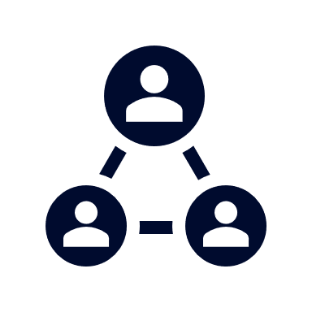



A Partner You Can Trust
OUR OBJECTIVES ARE ALIGNED
WE KNOW THE
MARKET
COMPLETELY TRANSPARENT
WE HAVE THE SOPHISTICATION AND INFRASTRUCTURE TO EFFECTIVELY COMPETE
Derek Moore, Senior Vice President – KBA
845-283-9973 * derek.moore@keybenefit.com

